Slide 1

Data hiding in a image with Steganography &Cryptography
as a web application using Django

Slide 2
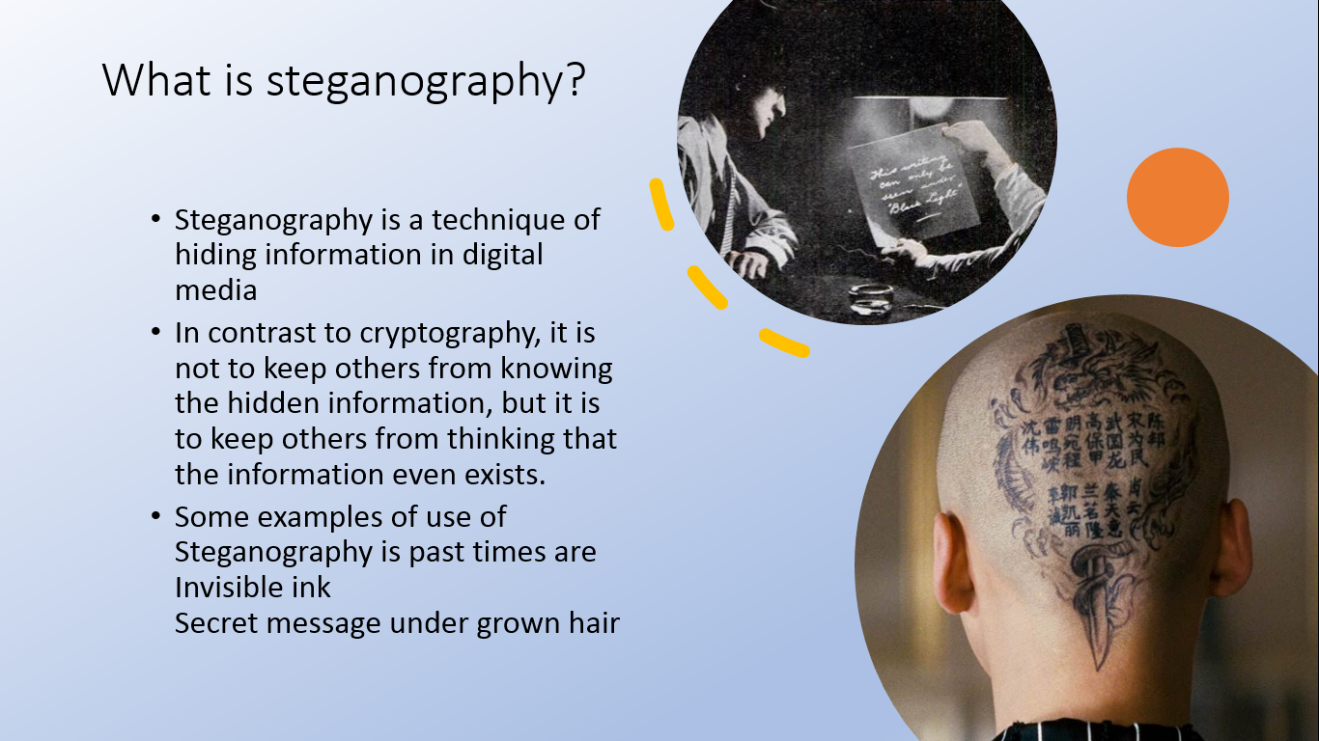

Slide 3
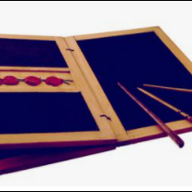
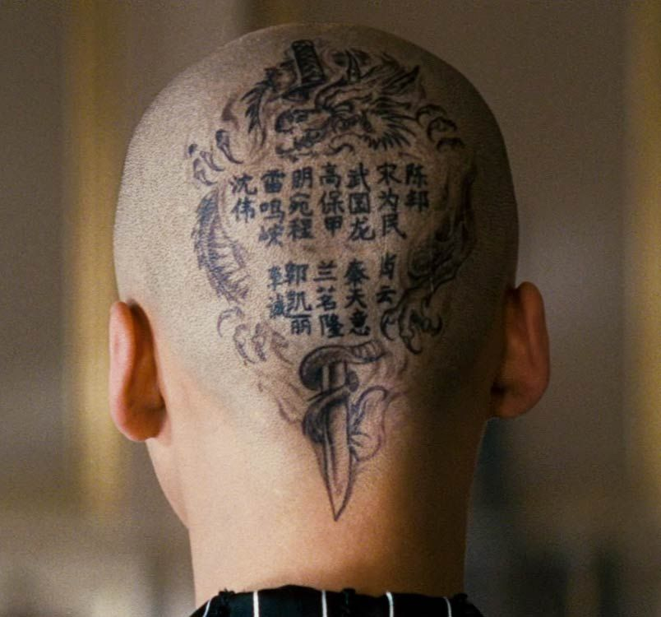
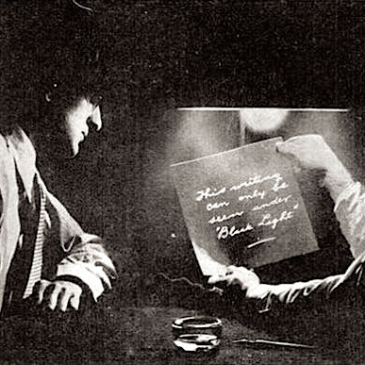
Wax tablets
Shaved heads
Invisible ink

Slide 4


What is Cryptography?
Cryptography is the science of encrypting and decrypting data. Based On complex mathematics.
plaintext
E(key)
ciphertext
ciphertext
D(key)
plaintext
SENDER
RECEIVER

Slide 5
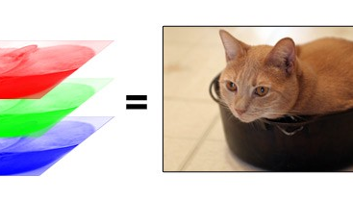
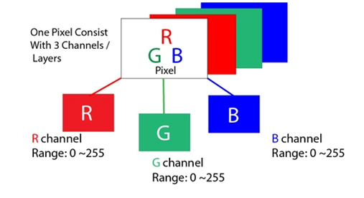
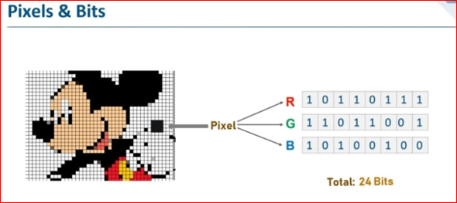
RGB Model

Slide 6
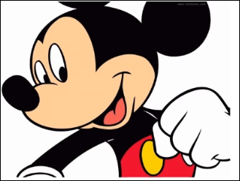
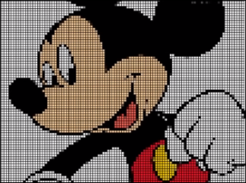

Slide 7
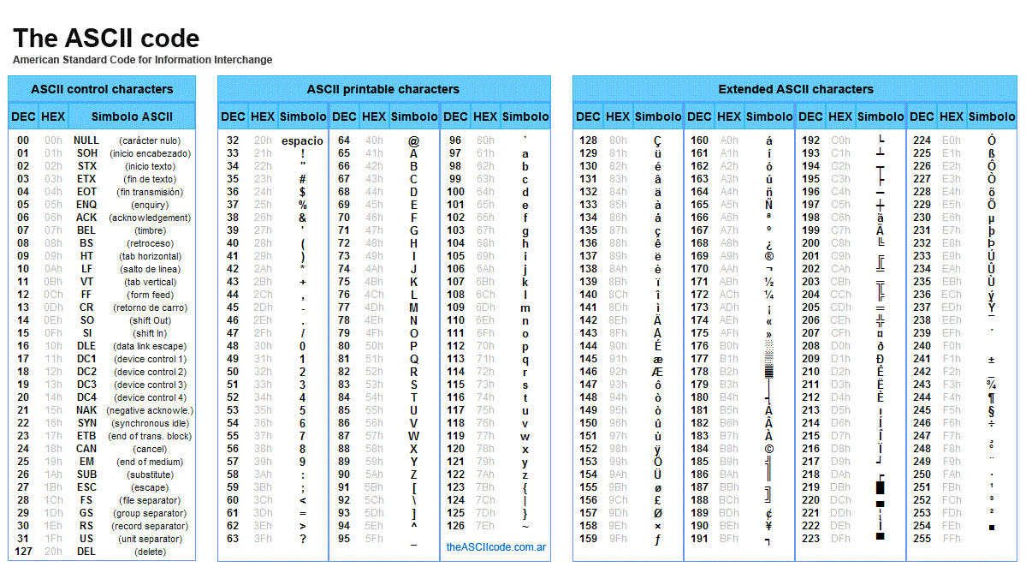

Slide 8

Embedding process

Slide 9
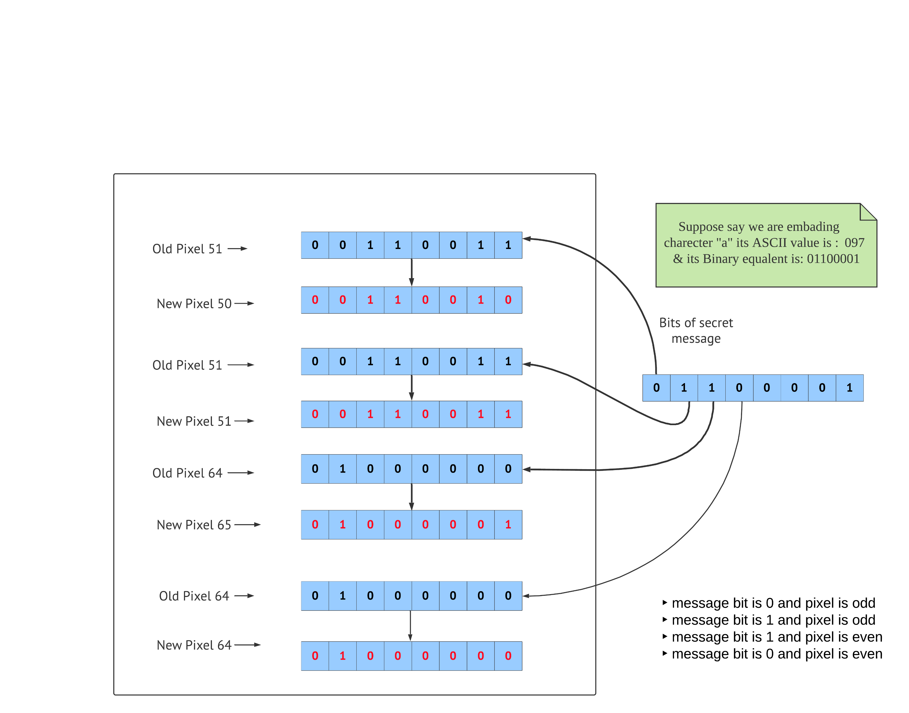

Slide 10
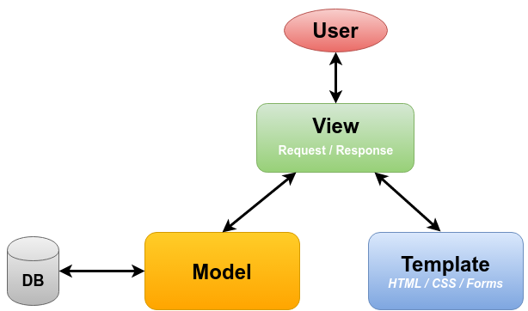
Working of Django framework

Slide 11
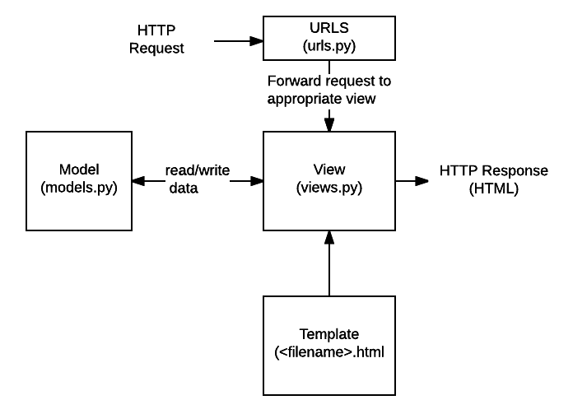
Working of Django framework

Slide 12
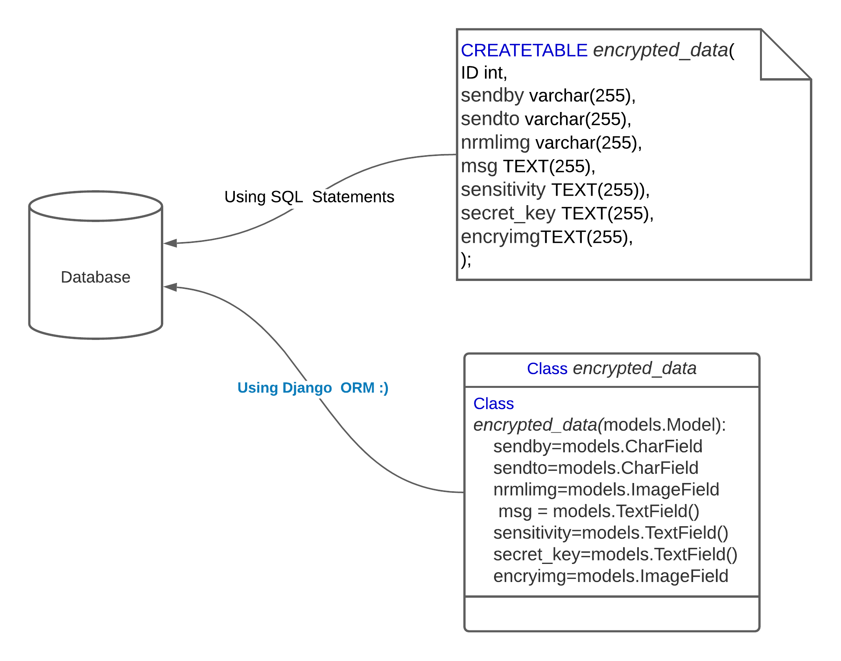
Django ORM (Object-Relational Mapper)

Slide 13
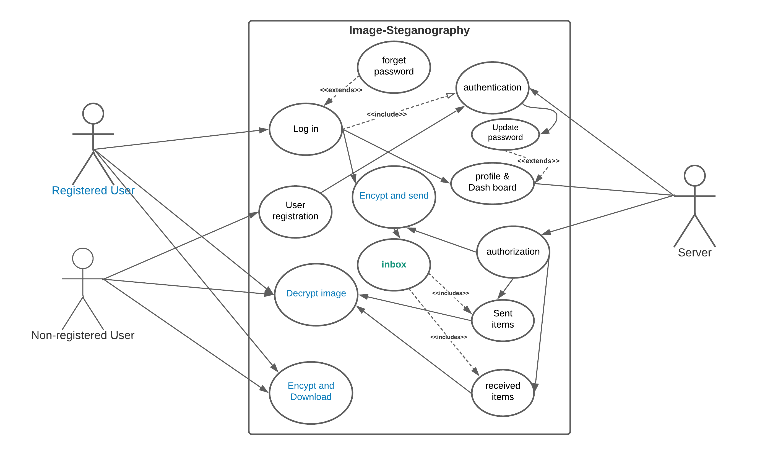

Slide 14


Images before and after Encryption
After Encryption
Before Encryption

Slide 15
Cryptographic algorithms

Slide 16
Data Encryption Standard (DES)
64 bits long plaintext block
64 bits long private key
we are going to shuffle the order
of the bits in the block containing 64 bits
shuffle the order of the bits
and omit 8 bits
(output contains 56 bits only)
initial permutation (IP)
permuted choice 1 (PC-1)
56 bits
48 bits
permuted choice 2 (PC-2)
56 bits
round #1
left circular shift
56 bits
48 bits
permuted choice 2 (PC-2)
56 bits
round #2
left circular shift
.
.
.
.
.
.
.
.
.
round #16
48 bits
permuted choice 2 (PC-2)
56 bits
left circular shift
shift all the bits to the left
(a table defines the number of shifts)
32 bit swap
left half (32 bits) and right
half (32 bits) are swapped
-1
64 bits
inverse permutation (IP )
CIPHERTEXT

Slide 17
Data Encryption Standard (DES)
What is the round-function?
32 bits
32 bits
28 bits
28 bits
L
R
K
K
l
r
expansion function
circular left shift
circular left shift
48 bits
XOR
48 bits
permuted choice 2 (PC-2)
48 bits
S-BOX
K
in the next round
K
in the next round
l
r
32 bits
permutation
„ROUND FUNCTION”
32 bits
XOR
L
in the next round
R
in the next round

